Slide 1
TEACHER CUE
CFU
HINT
Scaffolding for students
MAKE THE CONNECTION
Allow students to make the connection

Slide 2
SWBAT use Ohm’s law to describe the relationship between voltage, current and resistance
TRACK WITH ME
READ WITH ME
I can relate voltage, current and resistance
^{I can use Ohm’s law}

Slide 3
SWBAT use Ohm’s law to describe the relationship between voltage, current and resistance
MAKE THE CONNECTION
In the investigation what was the relationship between current and resistance?

Slide 4
SWBAT use Ohm’s law to describe the relationship between voltage, current and resistance
Current is unpredictable.
We cannot tell what it will be until we turn it on
Resistance is the factor playing out here

Slide 5

SWBAT use Ohm’s law to describe the relationship between voltage, current and resistance
Resistance
Resistance is how hard it is for the electrons to flow through something.
High resistance= slower movement
Low resistance= faster movement

Slide 6
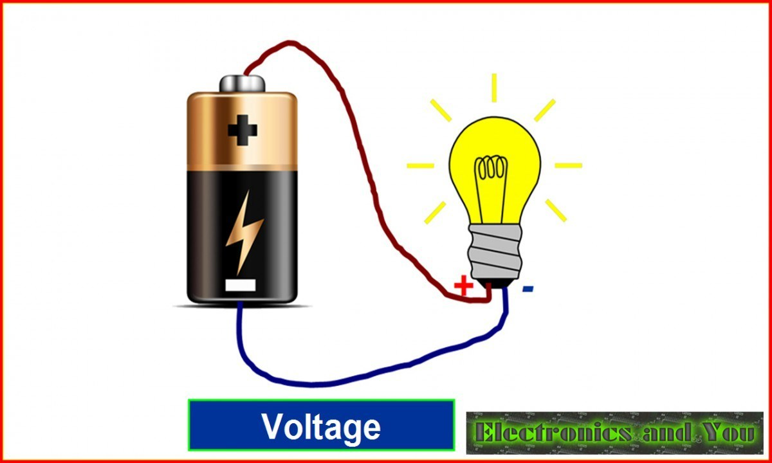
SWBAT use Ohm’s law to describe the relationship between voltage, current and resistance
Resistance is also related to voltage
The voltage lost in a circuit is due to the resistance of the material

Slide 7
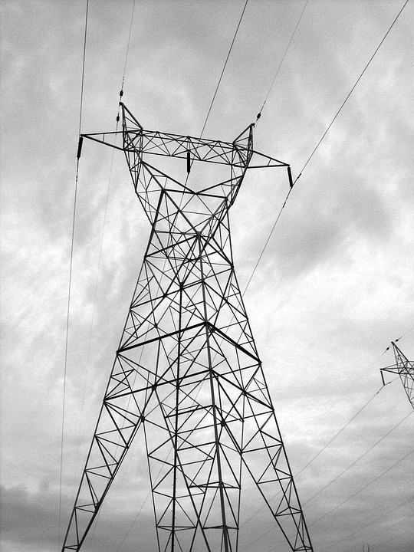
SWBAT use Ohm’s law to describe the relationship between voltage, current and resistance
TEACHER CUE
CFU- 3 responses
In your workbook can you write why powerlines have a really high voltage pumped through when we only use household objects with far less voltage requirements?

Slide 8
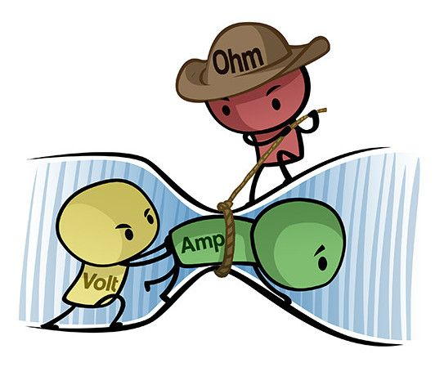
SWBAT use Ohm’s law to describe the relationship between voltage, current and resistance
Resistance and Current
As the resistance increases current is reduced as less electrons are able to pass through.
Dependent on:
Material that component (wire or substance current is passing through) is made of
Length of the wire
Thickness of wire

Slide 9
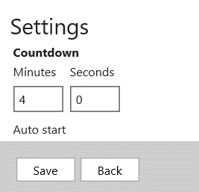
Can you identify whether each of these situations will have high or low resistance
Component is made of copper
Wire is made thin
Short wire
Component is made of rubber
Wire is made thick
Long wire
Notes:
Thick wire- low resistance. Thin wire- high resistance. Copper- low resistance. Rubber- high resistance. Long wire- high. Short wire- low

Slide 10
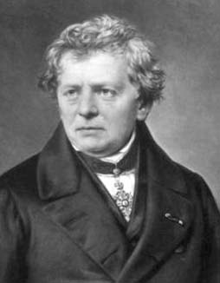
SWBAT use Ohm’s law to describe the relationship between voltage, current and resistance
Putting it all together
Ohm’s Law
Relates current, resistance and voltage
Georg Simon Ohm 1789-1854
Resistance (R) = Voltage (V) (in V)
(in Ω) Current (I) (in A)
V
I
R
Usually written as V=IR

Slide 11
SWBAT use Ohm’s law to describe the relationship between voltage, current and resistance
V
Can you calculate the current based on this situation below:
The original voltage into the circuit is 6V
The resistance is measured via a multimeter as 2Ω
I
R

Slide 12
SWBAT use Ohm’s law to describe the relationship between voltage, current and resistance
TRACK WITH ME
READ WITH ME
I can relate voltage, current and resistance
^{I can use Ohm’s law}

